Slide 1
Start recording now.

Slide 2
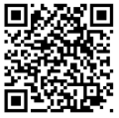
NAFNP Membership
Twelve hours of live Continuing Education credits per year, included with Membership
Local and national networking opportunities
Access Group Mentoring Sessions (live and recorded) covering key topics such as:
Interviewing as an FNP
Contract Negotiation & Malpractice Insurance
Full Practice Authority
Certification Documentation
Transition to Practice
CV and Resume Preparation
Mentorship opportunities: Work side by side with experienced FNPs on our committees, gaining invaluable insights and guidance.
Career Center: Find you dream job in our FNP-focused Career Center
Advocacy: Be part of a collective voice advocating for the interests and recognition of Family Nurse Practitioners at local, state, and national levels.
Scan for three months free with one-year membership!
© NAFNP 2025

Slide 3
NAFNP Meeting Legal Disclaimer
This event is organized by the National Association of Family Nurse Practitioners LLC™ (NAFNP) for educational purposes.
By participating in this meeting, you agree to the following terms:
Privacy and Confidentiality: Please be aware that this meeting may be recorded for documentation and archival purposes. By joining, you consent to being part of the recording and to have the recording made available publicly on multiple platforms. Your name, image, voice and comments will be recorded and may be transmitted over the internet, stored, exhibited, and broadcast without compensation or further notice. All Chat entries are captured, retained and shared. You consent to the use of Artificial Intelligence (AI) to transcribe this event. Protect the privacy and confidentiality of all participants. Do not share sensitive or personal information during the meeting. HIPPA or FERPA-protected information shall not be shared at any time.
Professional Conduct: Treat all participants with respect and professionalism. Any form of harassment, discrimination, or inappropriate behavior will not be tolerated. Your participation may be terminated at the sole discretion of NAFNP. Use the chat and Q&A features responsibly. Avoid sharing offensive, defamatory, or harmful content.
Content Disclaimer: The views expressed during this meeting are those of the individual speakers and do not necessarily represent the official stance of NAFNP. NAFNP does not endorse or approve any specific products, services, procedures, or organizations mentioned during the meeting.
Legal Terms: This meeting is subject to the laws and regulations of the jurisdiction of Cook County, IL where NAFNP is registered. Any legal disputes arising from this meeting will be resolved according to the Terms and Conditions of the National Association of Family Nurse Practitioners and applicable laws. All content copyright the National Association of Family Nurse Practitioners LLC™ (2025) and may not be used without express written permission from the Executive Director, NAFNP.
Intellectual Property: All materials presented during the meeting, including slides, handouts, and recordings, are the intellectual property of NAFNP and the respective presenters. Unauthorized use, reproduction, or distribution of these materials is prohibited.
Technical Issues: NAFNP is not responsible for any technical issues participants may experience during the meeting, including but not limited to connectivity problems, software malfunctions, or hardware failures.
Recording and Distribution: Participants are not permitted to record, reproduce, or distribute any part of the meeting or the content within without prior written consent from the Executive Director of NAFNP.
Liability: NAFNP is not liable for any direct, indirect, incidental, or consequential damages arising from participation in this meeting.
By joining this Zoom meeting, you acknowledge that you have read and understood this disclaimer and agree to comply with its terms.
© NAFNP 2025

Slide 4
Presentation Title
Author First Name, Last Name
Credentials
© NAFNP 2025

Slide 5

© NAFNP 2025

Slide 6

© NAFNP 2025

Slide 7
© NAFNP 2025

Slide 8
© NAFNP 2025

Slide 9
© NAFNP 2025

Slide 10
© NAFNP 2025

Slide 11
© NAFNP 2025
Notes:
Map from: https://www.ncsbn.org/nursing-regulation/practice/aprn/aprn-consensus-implementation-status.page

Slide 12
© NAFNP 2025

Slide 13
© NAFNP 2025

Slide 14
© NAFNP 2025

Slide 15
© NAFNP 2025

Slide 16
© NAFNP 2025

Slide 17
Map from: https://www.aanp.org/advocacy/state/state-practice-environment
© NAFNP 2025
Notes:
Map from: https://www.aanp.org/advocacy/state/state-practice-environment
Full Practice
State practice and licensure laws permit all NPs to evaluate patients; diagnose, order and interpret diagnostic tests; and initiate and manage treatments, including prescribing medications and controlled substances, under the exclusive licensure authority of the state board of nursing. This is the model recommended by the National Academy of Medicine, formerly called the Institute of Medicine, and the National Council of State Boards of Nursing.
Reduced Practice
State practice and licensure laws reduce the ability of NPs to engage in at least one element of NP practice. State law requires a career-long regulated collaborative agreement with another health provider in order for the NP to provide patient care, or it limits the setting of one or more elements of NP practice.
Restricted Practice
State practice and licensure laws restrict the ability of NPs to engage in at least one element of NP practice. State law requires career-long supervision, delegation or team management by another health provider in order for the NP to provide patient care.

Slide 18
© NAFNP 2025

Slide 19
© NAFNP 2025

Slide 20
© NAFNP 2025

Slide 21
© NAFNP 2025
Notes:
McMullen, P., Howie, W. (2020). Credentialing and Privileging: A Primer for Nurse Practitioners. The Journal for Nurse Practitioners, (16) 91-95.

Slide 22
© NAFNP 2025

Slide 23
References
© NAFNP 2025

Slide 24
References
© NAFNP 2025

Slide 25
© NAFNP 2025

Slide 26
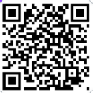
NAFNP Student Membership
Available to students and new graduates (up to 1 yr. post graduation), NAFNP membership offers a wealth of benefits designed to support your professional journey:
Exclusive Student Resources: Access Group Mentoring Sessions (live and recorded) covering key topics such as:
Interviewing as an FNP
Contract Negotiation & Malpractice Insurance
Full Practice Authority
Certification Documentation
Transition to Practice
CV and Resume Preparation
Mentorship opportunities: Work side by side with experienced FNPs on our committees, gaining invaluable insights and guidance.
Career Center: Find you dream job in our FNP-focused Career Center
Advocacy: Be part of a collective voice advocating for the interests and recognition of Family Nurse Practitioners at local, state, and national levels.
Discounted Student rate $89 per year
Three months free with one-year membership!
Scan to join
© NAFNP 2025

Slide 27
Stop recording now.
© NAFNP 2025

Slide 28

Upcoming
September 19
October 21
November 21
November
Human Trafficking
Breast Cancer in Primary Care: What Every FNP Should Know
Type 1 Diabetes: Early Detection and Treatment Update
When Things Go Wrong In Clinic
December 2
2026
2026
2026
Migraine Management in Primary Care
Documentation, Billing & Coding
NP Role Development
After Your First Year of Practice
NAFNP.ORG/JOIN
August
2025
© NAFNP 2025

Slide 29
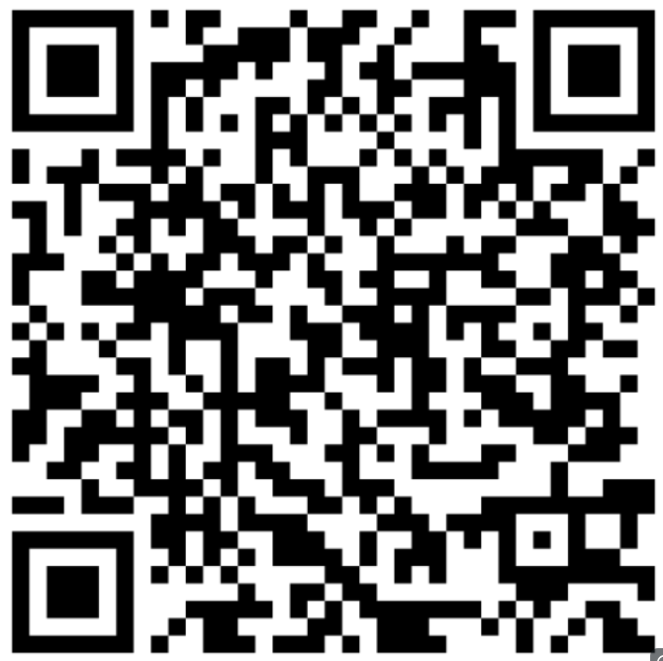
Continuing Education
This meeting qualifies for 1 hour of CEUs.
Use QR code to visit: https://www.rushu.rush.edu/checkin
Click ‘Sign in to claim attendance.”
Enter email address and click ‘create account’
Or enter password to log in.
Enter Code: *****
© NAFNP 2025

